Slide 1


Object Detection with Yolo Model.
Stephen Kamau ML Engineer, Kenya
Nairobi

Slide 2

It is a cutting edge Real-time object detection algorithm.
You Only Look Once(YOLO), requires only a single forward propagation through a neural network to detect objects hence the name.
It makes predictions of bounding boxes and class probabilities all at once.
It is fast and can run as high as 45FPS.
What is Yolo?

Slide 3
Prior detection systems repurpose classifiers or localizers to perform detection. They apply the model to an image at multiple locations and scales. High scoring regions of the image are considered detections.
We use a totally different approach in Yolo. We apply a single neural network to the full image. This network divides the image into regions and predicts bounding boxes and probabilities for each region. These bounding boxes are weighted by the predicted probabilities.
It looks at the whole image at test time so its predictions are informed by global context in the image. It also makes predictions with a single network evaluation unlike systems where you need to evaluate several times.
It uses 3 techniques for detection i.e
Residual blocks (Creating an S * S grid from the image)
Bounding box regression (predict the height, width, center, and class of objects)
Intersection Over Union (IOU) - To check how bbox overlaps and get the best fit.
How Does It Work?

Slide 4
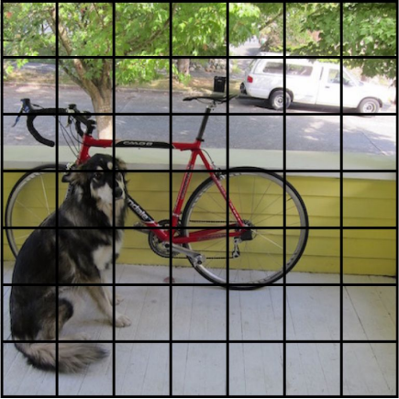
The image is divided into a grid of S * S of equal dimension.
Each grid is responsible for detecting Objects within them.
Residual blocks Process?

Slide 5
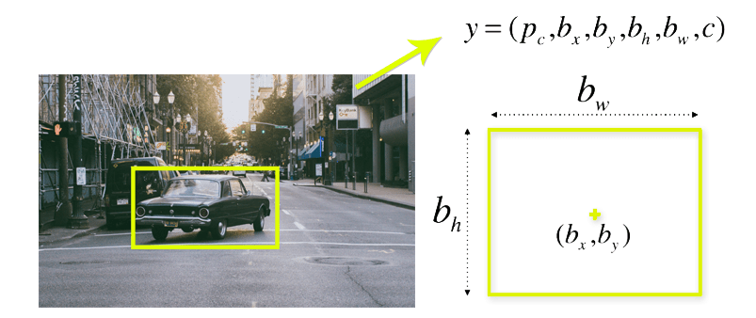
A bounding box is an outline that highlights an object in an image.
Every bounding box in the image consists of the following attributes; Width (bw), Height (bh), Class Label (c) and Bounding box center (bx,by).
A single Bbox regression is used to predict the height, width, center, and class of objects.
Bounding box regression?

Slide 6
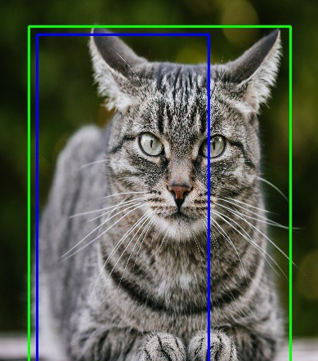
IOU is a method in object detection that describes how boxes overlap and is used to provide an output box that surrounds the objects perfectly.
Each grid cell is responsible for predicting the bounding boxes and their confidence scores. The IOU is equal to 1 if the predicted bounding box is the same as the real box. This mechanism eliminates bounding boxes that are not equal to the real box.
In case of Image shown, green is the real bbox while blue is the predicted.
Intersection over union (IOU).

Slide 7
Training Your model
Training is not complicated, you will need;
Data that is in the correct format.
A directory named images as an example, which contains train|val|test subfolders and their labels.
Labels should be text files with format <class label> <center(x,y)> <dimension(w,h)>
Each image with bbox must have a single txt file.
All annotation bbox center, h and w must be normalized between 0 and 1.

Slide 8
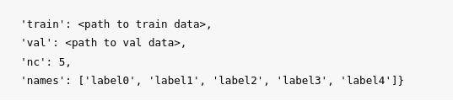
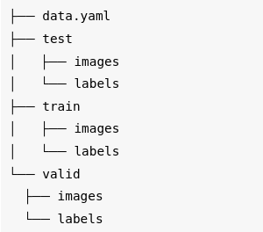
DATA AND FOLDER CONFIGURATION
Data Config file should have the following. Here is where the model refers to when it is training.
The data folders must be arranged as below, You can add test folder (optional).

Slide 9
Let's Do A demo While Showcasing training on a custom dataset.
DEMO

Slide 10
Real-Time Fire Detection With YOLO.
Presenter: Stephen

Slide 11


Thank You.
https://twitter.com/KamashStivec
https://github.com/Stephen-Kamau

